Slide 1
UHV-I
Day 6
Recap of Day 1-5
…

Slide 2
UHV-I
Session 1
Welcome and Introductions
The idea was to get to meet and know each other!
How did it go?

Slide 3
UHV-I
Session 2
Exploring our Aspirations and Concerns
Planning for a fulfilling life by relating
academic success, career… expectations of family, peers…
to our basic aspiration…

Slide 4

How Would you Plan Your Life to Fulfil Your Basic Aspiration?
?
??
???
Present Effort
(1)
to Become
(2)
to Get/Do
(3)
to Be
(4)
To be happy and prosperous
In continuity!
Plan with effort, steps at the base
Understand basic aspiration and plan the effort with that clarity
Basic Aspiration
The basic human aspiration is for the continuity of happiness and prosperity
We are making effort to realise our aspirations
(yet, there are problems, so we are trying to resolve them also)
Essential to fulfil our basic aspiration
  Understand our basic aspiration (continuous happiness and prosperity)
  Understand the program to fulfil our basic aspiration
  Make focused effort for it (plan the steps with clarity of our basic aspiration…)
There are multiple steps, ways to fulfil our basic aspiration
If one way is closed, we can always pick another way
UHV is intended to help us with this

Slide 5
UHV-I
Session 3
Basic Human Aspiration and its Fulfilment
Setting the correct priorities in life

Slide 6
Basic Human Aspiration and Program for its Fulfilment
PROGRAM:
Understanding Harmony
RIGHT UNDERSTANDING
(le>)
in the self
Understanding Harmony:
Harmony in Human Being
Harmony in Family
Harmony in Society
Harmony in Nature/Existence
VALUES
1
Education –
Understanding
2
3
RELATIONSHIP (laca/k)
with human being
PHYSICAL FACILITY
(lqfo/kk)
with rest of nature
Living in Harmony
all 4 levels:
Individual
Family
Society
Nature/Existence
SKILLS
Sanskar –
Living
Living in Harmony
with human being
Living in Harmony
with rest of nature
MUTUAL HAPPINESS
(mHk; lq[k)
MUTUAL PROSPERITY
(mHk; le`f))

Slide 7
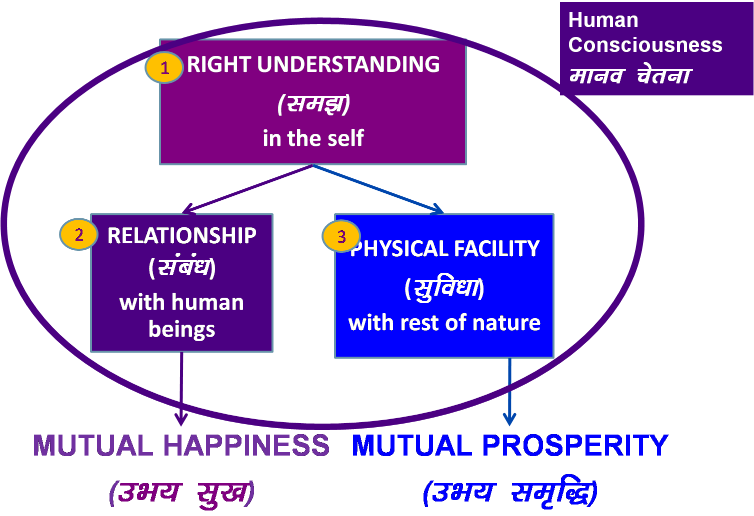
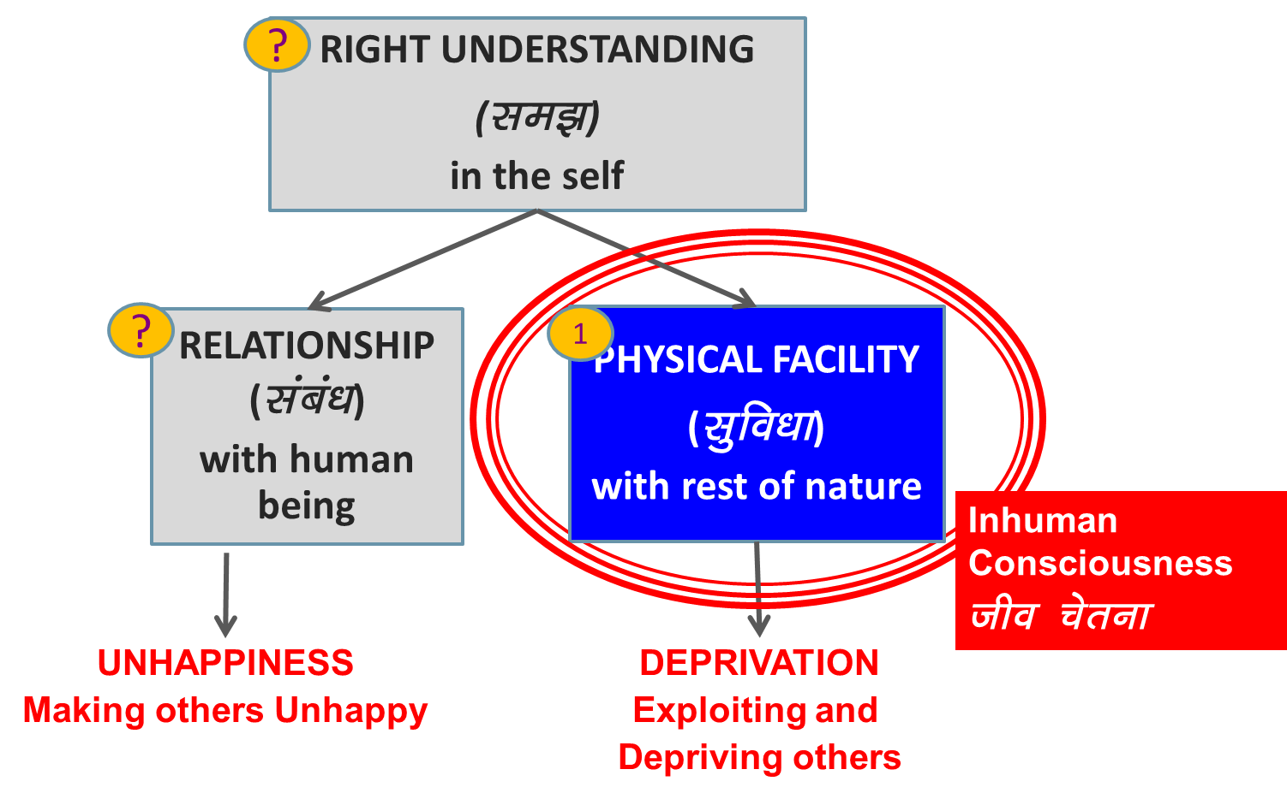

Holistic Development (विकास)
Is development just in increasing physical facility or development is ensuring of all 3?
Where do you want to be – on the left or on the right?
Is this transformation desirable?
Are we making effort for it?
Transformation& Progress
परिमार्जन-विकास
Do you need to make effort for it?
Should education help you to make this effort?

Slide 8
UHV-I
Session 4
Program for Fulfilment of Basic Human Aspiration
Shifting from excitement to happiness…

Slide 9

Process of Self-exploration
Whatever is stated is a Proposal
Verify it on your own right
(Do not assume it to be true/ false)
Proposal
1
2
Verify
on the basis
Of
your
Natural
Acceptance
Experiential Validation
Live according to it
2a
2b
Behaviour with
Human Beings
Work with
Rest of Nature
Mutual Happiness
Mutual Prosperity
Which process is Naturally Acceptable to you?
A process of self-exploration, self-verification on your own right,
leading to understanding in yourself
or
A process of do’s & don’ts, in which you assume what is said, without verification
RIGHT
UNDERSTANDING

Slide 10
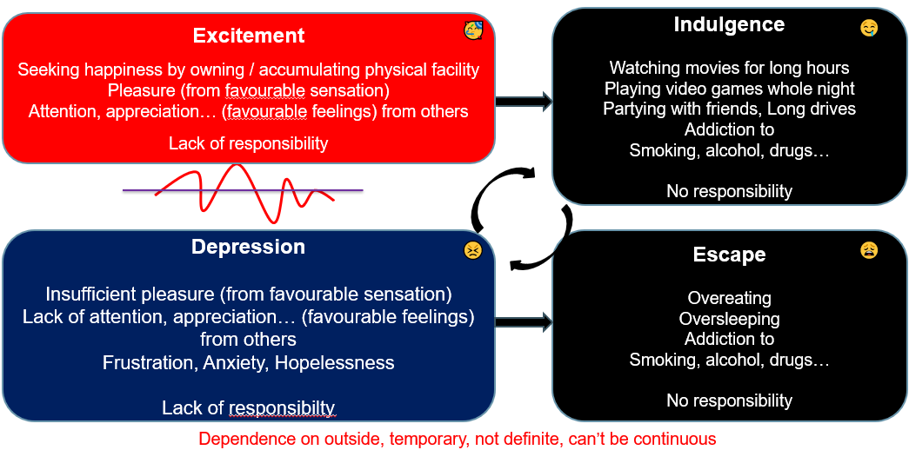
Excitement-Depression to Happiness Desired State
Happiness
Harmony
Right understanding
Right feeling
Responsibility
😊
Continuous, definite
No fluctuations
No dependence on outside

Slide 11
Prosperity (le`f))
Prosperity – The feeling of having / producing more than required Physical Facility
le`f) & vko”;d lqfo/kk ls vf/kd dh miyfC/k@ mRiknu dk Hkko
Prosperity and Possession of Wealth are two different things
Do you want to be a billionaire or a prosperous person? Ask yourself
Are you sure that by becoming a billionaire, you are going to be happy in continuity??
A prosperous person thinks of right utilisation, nurturing the other
“ deprived “ “ “ accumulation, exploiting “ “
le`) O;fDr lnqi;ksx dk] nwljs dk iks"k.k djus dk lksprk gS
nfjnz “ laxzg “ “ “ “kks"k.k “ “ “ “

Slide 12
UHV-I
Session 5
Fulfilment of Aspirations at the Individual level
Distinguishing between the needs of Self and Body

Slide 13
Human Being Ekkuo | Self (I) eSa | Body “kjhj
Need vko';drk | Happiness (e.g. Respect) lq[k ¼tSls lEeku½ | Physical Facility (e.g. Food) lqfo/kk ¼tSls Hkkstu½
In Time dky esa | Continuous fujUrj | Temporary lkef;d
In Quantity ek=k esa | Qualitative (is Feeling) xq.kkRed ¼Hkko gS½ | Quantitative (Required in Limited Quantity) Ekk=kRed ¼lhfer ek=k esa½
Fulfilled By iwfrZ ds fy, | Right Understanding & Right Feeling lgh le>] lgh Hkko | Physio-chemical Things HkkSfrd&jklk;fud oLrq
Co-existence
lgvfLrRo
Can you see that
  Both type of needs have to be understood separately
  Both type of needs have to be fulfilled separately
When we mix up the two, we are in trouble!
Notes:
Fulfilled by
Flower to Father – flower is only a symbol. Feeling is primary. Feelings ka bandh mein band kar rakha hai – feelings ka aadan-pradan nahin hota. Feelings ka exchange bhi sukhi hone ka tareeka hai, yeh dhyan mein nahin aaya rahta
One cant fulfill the other
Exclusive dress – attention neq respect. Dress se attention bhar mil paata hai

Slide 14
When we mix up the two, we are in trouble!
Human Being Ekkuo | Self (I) eSa | = | Body “kjhj
Need vko’;drk | Respect lEeku | = | Physical Facility (Eg. Food, Clothes) lqfo/kk (tSls&Hkkstu] diM+k)
 | Continuous fujUrj | = | Unlimited vlhfer
Feeling of Deprivation
I don’t have enough!
Accumulation = unlimited?
Effort for Physical Facility
by any means?
Accumulation of Physical Facility – Unlimited!
Lqfo/kk laxzg & vlhfer!
Loop
Check if you
are caught up
In this loop
Deprivation
nfjnzrk

Slide 15
Every Human Being has a Natural Acceptance – The Internal Guide
This part is definite, un-corrupted, pure, innate in every Self!
We may or may not be aware of it
We have the potential to be aware of it, and to take guidance from it!
INTENTION
What I really
want to be
Desired State
Natural Acceptance
Dialogue?
Guiding?
Our feeling, imagination may keep fluctuating
When our feeling, imagination is guided by our Natural Acceptance, we are in harmony within… we are happy!
COMPETENCE
What I am
Current State
Imagination
Notes:
The dialogue within is the dialogue between my imagination and my natural acceptance
Between my competence and my intention
Between “what I am” and “what I really want to be”
The natural acceptance is always for relationship
My imagination may or may not always be for relationship! Sometimes it is for opposition!
Now whenever my imagination is in harmony with my natural acceptance, I am in a state of happiness!
Whenever my imagination is in contradiction with my natural acceptance, I am in a state of unhappiness!
So to be in harmony, all I have to do is to
Be aware of my natural acceptance
Be aware of my imagination
Ensure the dialogue and ensure that my imagination is in line with my natural acceptance

Slide 16
UHV-I
Session 6
Resolution of Concerns at the Individual Level
Developing self-confidence, overcoming peer pressure…

Slide 17

Sources of Imagination
1.
2.
3. | Desire bPNk
4. | Thought fopkj
5. | Expectation vk'kk
Activity fØz;k
Imaging fp=.k
Analysing-Comparing fo'ys"k.k&rqyu
Selecting-Tasting p;u&vkLoknu
Natural Acceptance
lgt Loh—fr
Self eSa
3
Self-organized Lora=rk √
Preconditioning ekU;rk
Content of Imagination
dYiuk”khyrk
dh oLrq
1
Enslavement ijra=rk X
Information
Body 'kjhj
2
Sensation laosnuk
Enslavement ijra=rk X
Behaviour O;ogkj
Work dk;Z
Notes:
Imagination may be motivated by sensation, preconditioning or NA (these are 3 possible sources of motivation for imagination)
Give small examples of each source of motivation
It is important to note that we are trying to communicate
Self is in harmony with the portion of imagination that is in line with Natural Acceptance (NA). We have to increase that % to 100%...
Preconditioning = Assuming without Knowing. We have to evaluate our preconditioning – if it is in line with NA, it will become part of our right understanding; if it is not in line with NA, it will drop. In this way we have to get rid of 100% of the preconditioning.
We don’t have to get rid of all Sensation - We only have to make right use of Sensation (e.g., for the health of the Body). If we are trying to derive happiness out of the sensation, then we have to get rid of it (by moving to the right source of happiness)

Slide 18
Resolution of Concern regarding Peer Pressure
Paying attention to the Natural Acceptance
Developing right understanding about human being leading to clarity about Self and Body
(need of Self, need of Body, sources of imagination…)
Developing right understanding about relationship leading to right feeling
(trust, respect…)
With right understanding, we are able to see trust as the foundation of every relationship
(and similarly we are able to ensure other feelings)
This understanding helps us come out of peer pressure (and resolve many other such concerns)
We will discuss about relationship in session 8

Slide 19


Imagination completely in line with Natural Acceptance → Complete Harmony in the Self
 |  | Activity fØz;k
1. |  | Realization vuqHko
2. |  | Understanding cks/k
3. | Desire bPNk | Imaging fp=.k
4. | Thought fopkj | Analysing fo'ys"k.k
5. | Expectation vk'kk | Selecting/Tasting p;u@vkLoknu
Right Understanding
in the Self
Natural Acceptance
INTENTION
What I Really Want to Be
Happiness
= To be in a state of Harmony
Lkq[k
¾ laxhr esa] O;oLFkk esa thuk
Guiding
Content of imagination
In harmony
COMPETENCE
What I Am
Information
Body 'kjhj
Behaviour O;ogkj
Work dk;Z

Slide 20
UHV-I
Session 7
Ensuring Health Holistically
Making a definite program for health

Slide 21
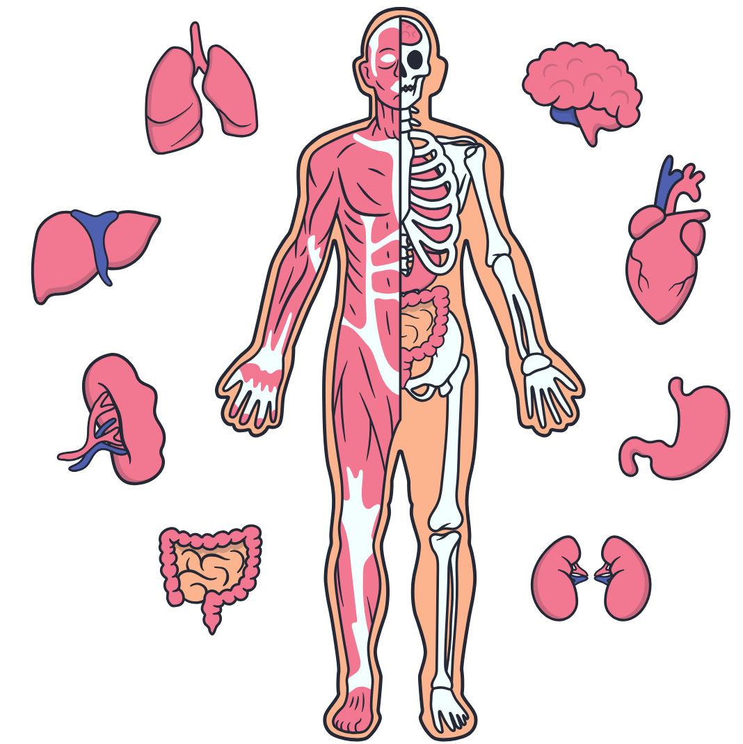
Feeling of Self-regulation (संयम) → Program for it → Health in the Body
The Body is an orderly system (a harmony). It is composed of trillions of cells – these are working in a complimentary manner (forming tissues, organs, organ systems …), all for the harmony of the body!
All I (Self) have to ensure is the continuity of that harmony
(at least not disturb it).
With the feeling of responsibility toward the body,
I do what is required for fulfilling that responsibility.
This ensures the health in the Body.
We will explore a program to ensure health …..
Out of self-regulation and health, which holds the higher priority for you?

Slide 22
Program for Health of the Body
1
(A) For Staying Healthy
  1 Intake and Routine (Lifestyle)
  2 Labour and Exercise
  3 Postures for regulating internal & external body organs
  and Regulated Breathing
  4a Medicine and 4b Treatment
1a
1b
2
(B) For bringing body back to harmony from temporary disharmony
3
(C) Dependence on drug / machine to perform a body function

Slide 23
Holistic Perspective of Health
Mental health or health of the Self
    Understanding the human being
    Understanding the Self
      → harmony in the Self Healthy Self
Physical health or health of the body
    Understanding the body
      → harmony in the body Healthy Body
Conditions for mental and physical health
i.e. health of the environment
    Understanding the environment
      → harmony in the family
      → harmony in the society Healthy Environment
      → harmony in the nature/existence
1
2
3

Slide 24
Fulfilment in Relationship
UHV-I
Sessions 8-11

Slide 25
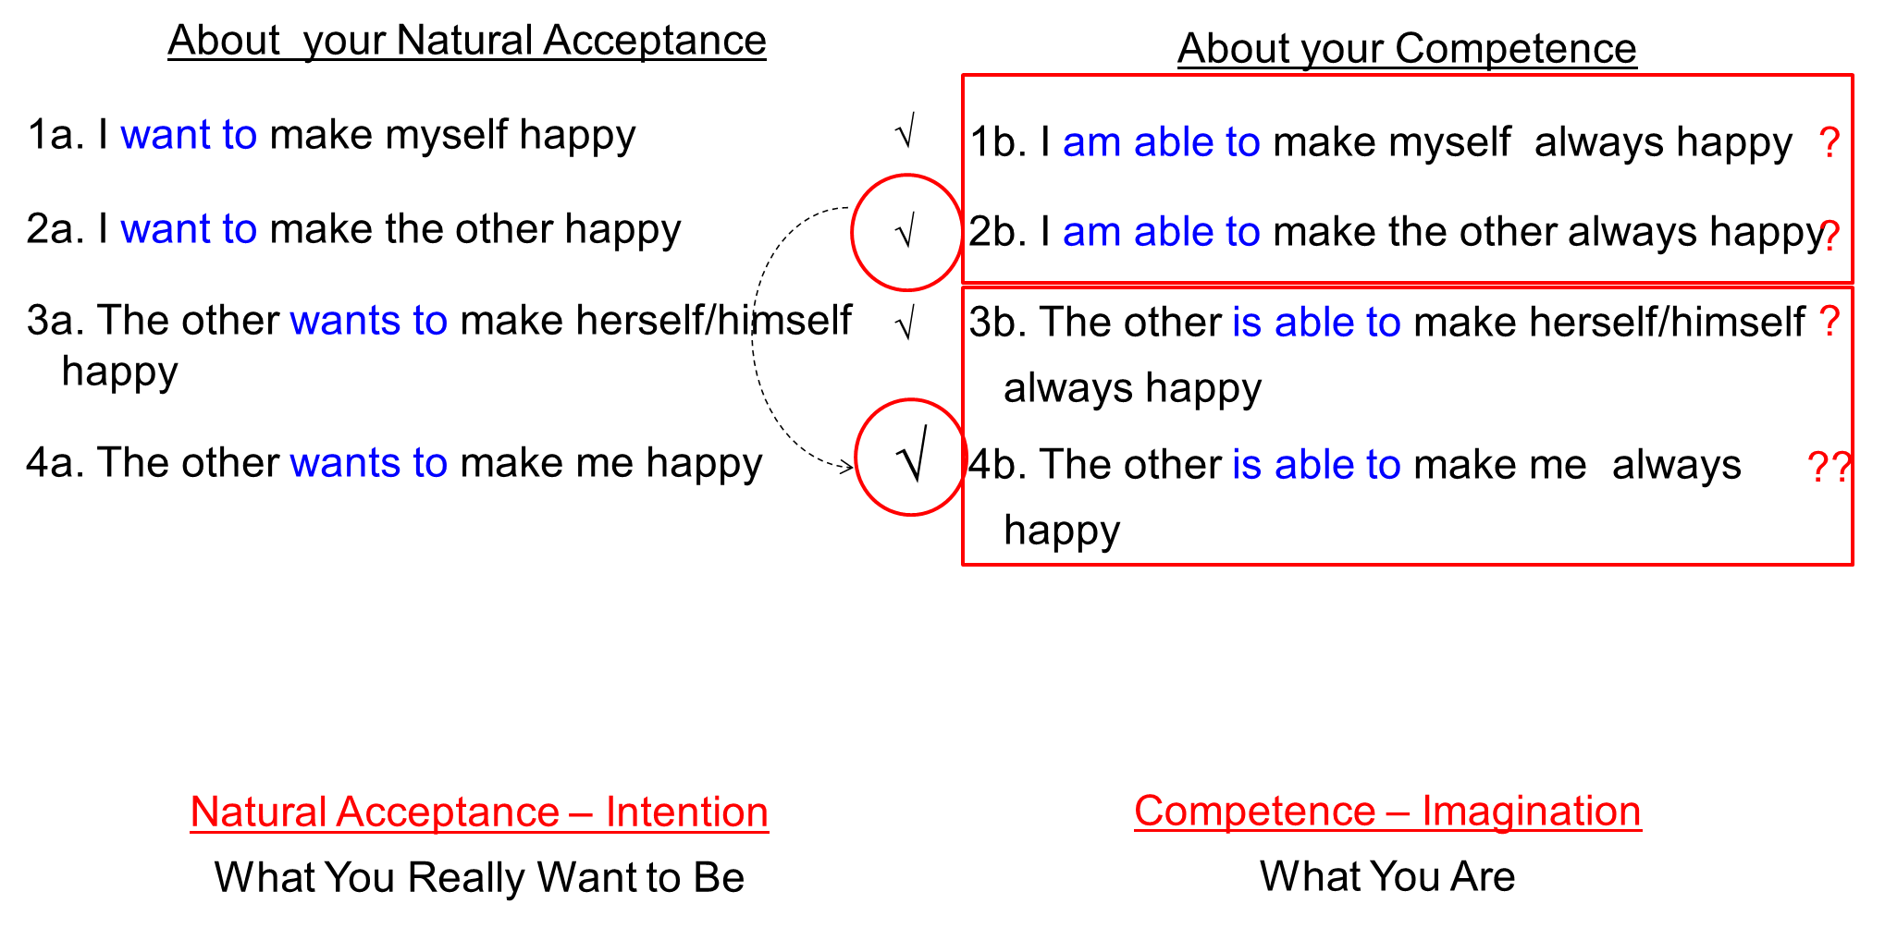
Trust – The Foundation Value
Trust is to be assured that the other intends to make me happy and prosperous
It is the foundation of relationship
I can see that the competence may be lacking in me also, not just in the other
Anger, irritation, opposition in me reduces…
I start working on developing my competence first and become a help in the development of the competence of the other
Trust on intention is the starting point for mutual development

Slide 26
Reaction
Response
You decide your feeling based on the behavior of the other
Your feeling depends on whether you like or dislike the (taste of the) behavior of the other
  If the other behaves properly, you have a right feeling and may behave properly
  If the other misbehaves, you have a wrong feeling and you may also misbehave
Your “remote control” is with the others
You are “enslaved”
Your conduct is indefinite
You decide your feeling on your own right
It is based on right understanding
You always have the right feeling
It is definite and unconditional
  The behavior of the other is only an indicator of the state of the other
  With that input you decide your behavior to ensure mutual happiness
You decide your own behaviour
You are self-organised
Your conduct is definite

Slide 27
Respect – Right-Evaluation
1. Purpose – Our purpose (Natural Acceptance) is same
2. Program – Our program is same
3. Potential – Our potential is same
The Other is Similar to Me
4. Competence – On the basis of right evaluation of our mutual competence, I recognise our complementarity and fulfill it:
  If the other has more understanding, is more responsible than me
      I am committed to understand from the other
  If I have more understanding, I am more responsible than the other
      I live with responsibility with the other, unconditionally, unperturbed by the behaviour of the other
      I am committed to facilitate understanding in the other (once the other is assured in relationship, and not before that)
COMPLETE CONTENT of RESPECT
The Other is Similar to Me. We are complementary to each other

Slide 28
Excellence, Reverence and Gratitude
Basic human aspiration = Continuous happiness
= To achieve excellence
Excellence ¼Js’Brk½
Understanding Harmony &
Living in Harmony
Continuous Happiness
Trust, Respect – For all
Reverence – For those who have achieved excellence
Gratitude – For those who have made effort for my excellence
at all 4 levels
  In the Human Being
  In Family
  In Society
  In Nature/Existence

Slide 29
Love – The Complete Value
Verify on the basis of your natural acceptance if you want to be related to:
    None → The feeling of being related to none – in opposition to all
    One → The feeling of being related to one
    Many → The feeling of being related to many
    Everyone → The feeling of being related to all
Affection (Lusg) – The feeling of being related to the other
(acceptance of the other as one’s relative)
nwljs dks laca/kh ds :i esa Lohdkjus dk HkkoA
Love ¼izse½ – The feeling of being related to all (Complete Value)
¾ gj ,d dks laca/kh ds :i esa Lohdkjus dk HkkoA
X
√
Affection
√
√
Love

Slide 30
Your Sharing
Takeaways
Questions
Observations…

